Slide 1

A comparative study of quantum and classical models for regression tasks, evaluating the potential of a quantum advantage.
—
Quantum machine learning for regression.

Slide 2
Outline
Introduction: Defining the Topic
Define my task
State of the Art: Review of Relevant Literature
Recap on Machine Learning
Introduction to Quantum Machine Learning (QML)
Detailing the Research Conducted
Future work
Reflections and Insights

Slide 3
Introduction
Quantum Computing for Material Simulation
Quantum Computing in PDE Simulations: Recent advances have generated interest in applying quantum computing to solve PDEs for various simulations.
Insights from Key Research: Research by M. Ali and M. Kabel [1] highlights significant doubts about the near-term feasibility of using quantum computing for PDEs, given current NISQ constraints.
Internship Focus: Exploring Quantum Machine Learning for regression tasks in material property prediction, as an alternative to directly solving PDEs with quantum computing.

Slide 4
Introduction
Quantum Computing for Material Simulation
Model Selection: Identify an effective Quantum learning model; architectures demonstrating quantum advantage in prediction tasks .
Dataset Generation: Employ classical PDE solvers to generate datasets for training, validating and testing the model.
Benchmarking: Compare quantum model’s prerformance to classical ML and PDE solutions existing solutions; assess accuracy, computational efficiency, and scalability.

Slide 5
My contribution
Reproduce and evaluate results on a Toy Case : The California Housing DataSet
Reproduce : the same input-output Relationship of Re-uploading quantum learning models for regression task using Neural Network and Fourier Series model.
Evaluate : the Neural Network performance and compare it to different benchmarks
Assess : a potential Quantum Advantage to use Quantum learning model for regression.

Slide 6
B. State of the Art:
Review of relevant literature
Farhi, E., & Neven, H. (2018). Classification with Quantum Neural Networks on Near Term Processors.
Schuld, M., Sweke, R., & Meyer, J. J. (2020). The effect of data encoding on the expressive power of variational quantum machine learning models.
Schuld, M. (2021). Supervised quantum machine learning models are kernel methods.
Jerbi, S., Fiderer, L. J., Nautrup, H. P., Kübler, J. M., Briegel, H. J., & Dunjko, V. (2021). Quantum machine learning beyond kernel methods.
Ali, M., & Kabel, M. (2022). A Performance Study of Variational Quantum Algorithms for Solving the Poisson Equation on a Quantum Computer.
Kordzanganeh, M., Sekatski, P., Fedichkin, L., & Melnikov, A. (2022). An exponentially-growing family of universal quantum circuits.
Schreiber, F. J., Eisert, J., & Meyer, J. J. (2022). Classical surrogates for quantum learning models.
Shin, S., Teo, Y. S., & Jeong, H. (2023). Exponential data encoding for quantum supervised learning.
Bowles, J., Wright, V. J., Farkas, M., Killoran, N., & Schuld, M. (2023). Contextuality and inductive bias in quantum machine learning.
Umeano, C., Paine, A. E., Elfving, V. E., & Kyriienko, O. (2023). What can we learn from quantum convolutional neural networks?

Slide 7
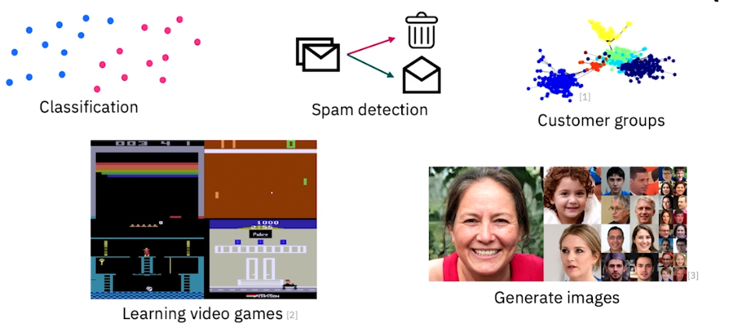
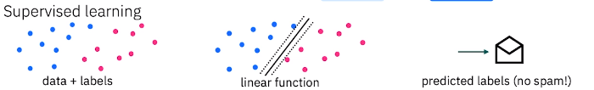
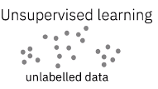

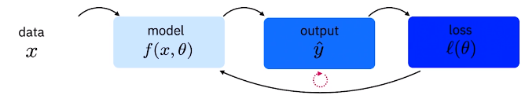
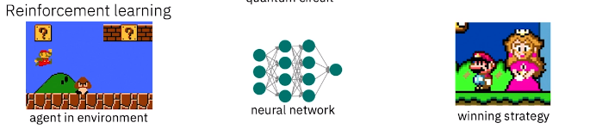
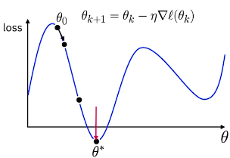
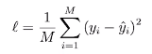
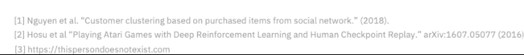
Machine learning
How does it work and what is it used for ?

Slide 8
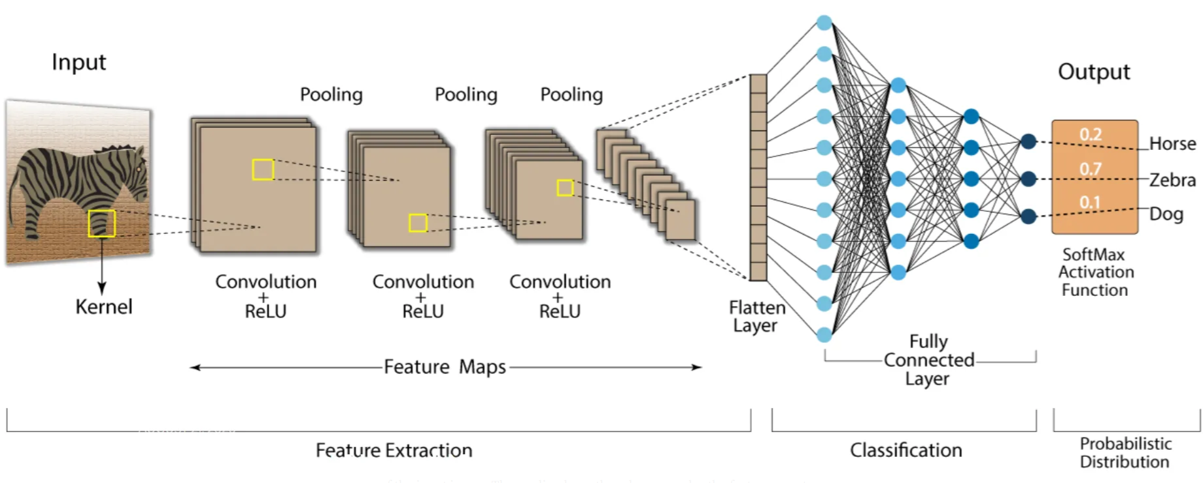
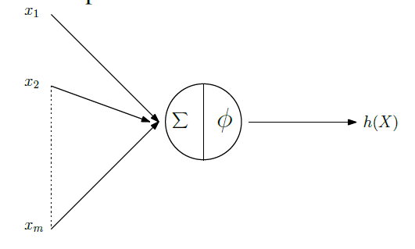
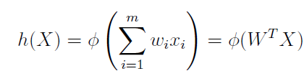
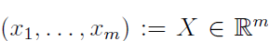
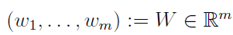
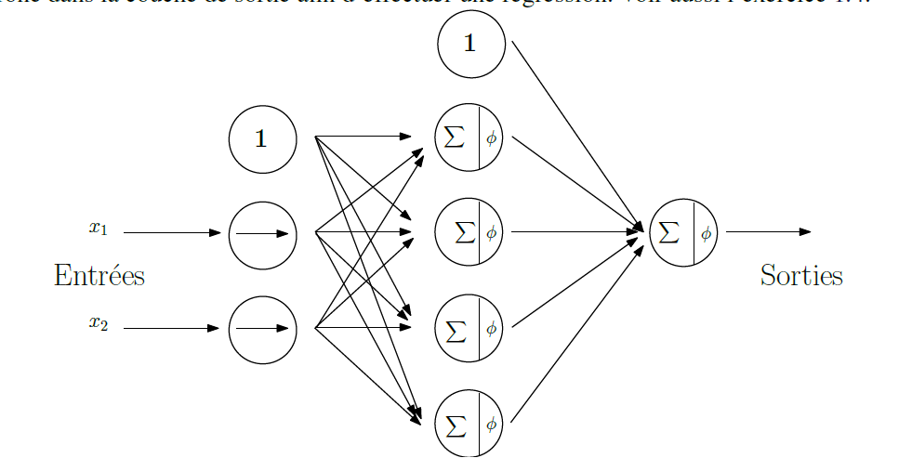
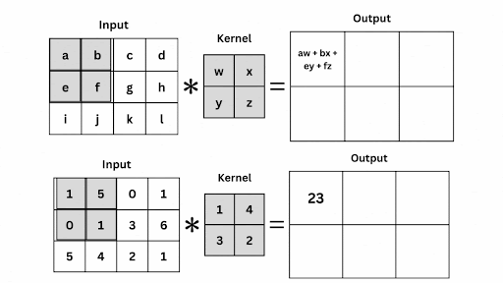

Machine learning
Neural Networks and Convolutional Neural Networks

Slide 9
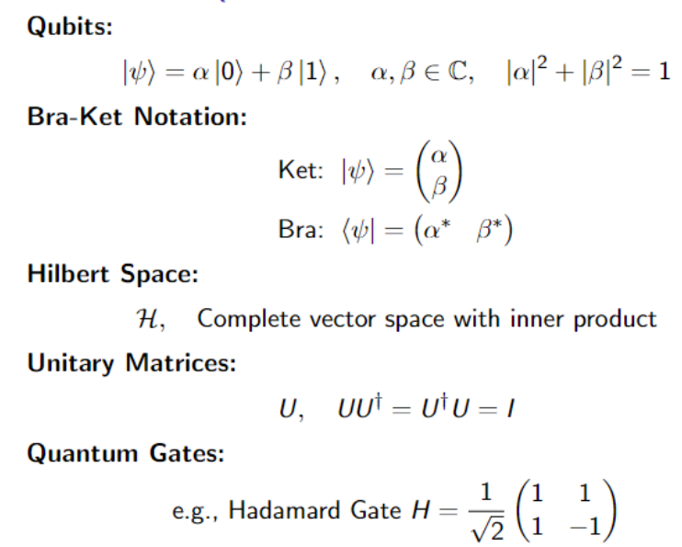
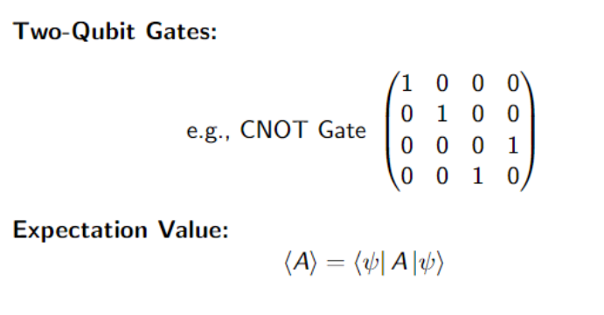
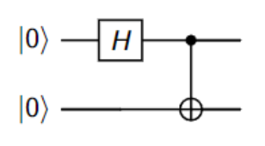
Quantum Computing

Slide 10
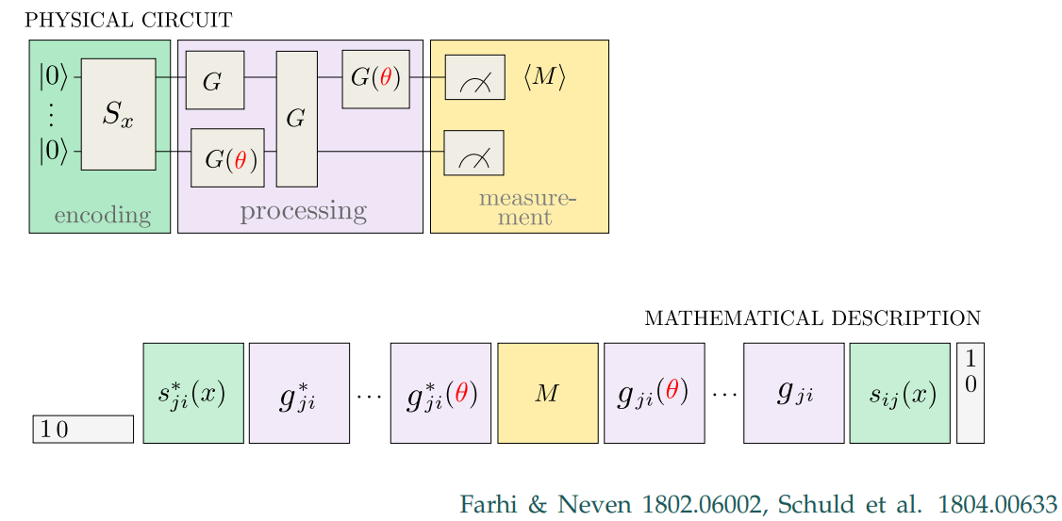
Manipulation of Quantum Bits

Slide 11
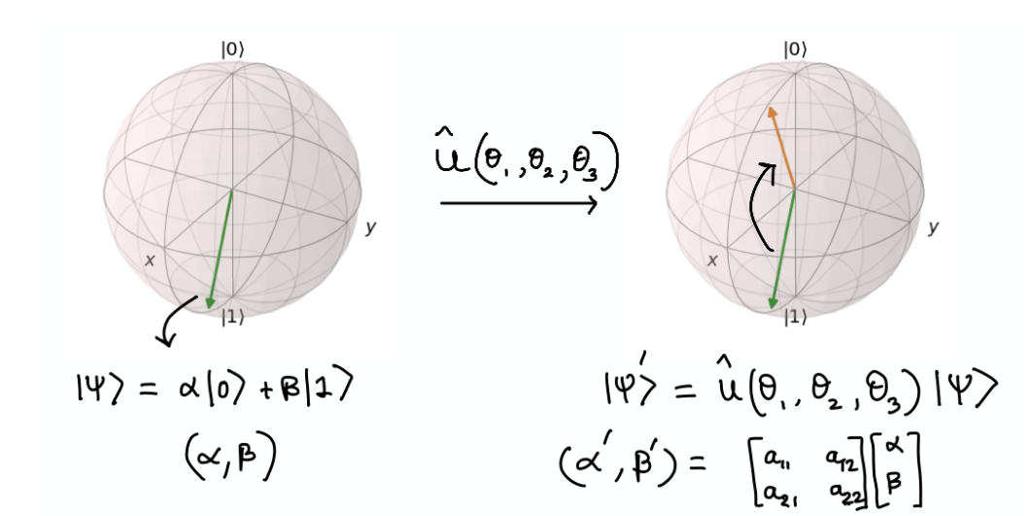
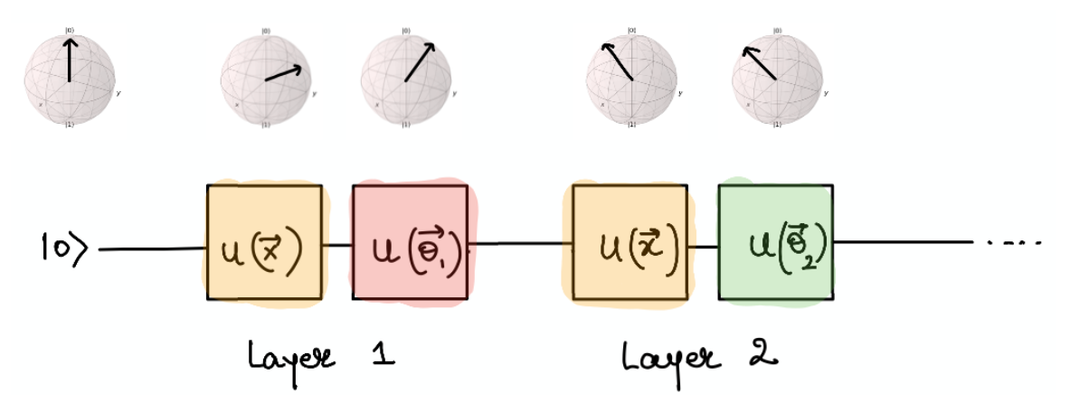
Quantum Machine Learning

Slide 12
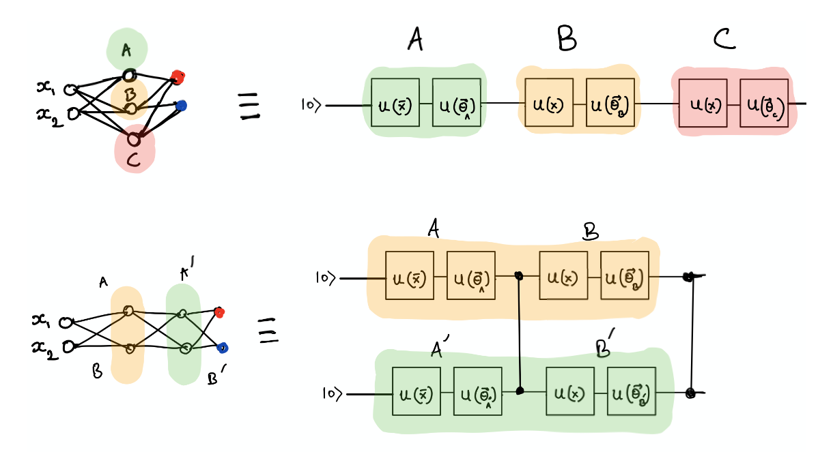
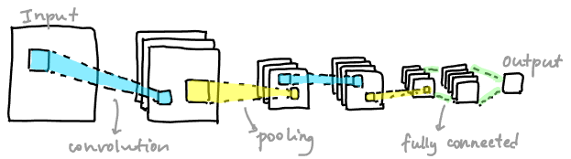
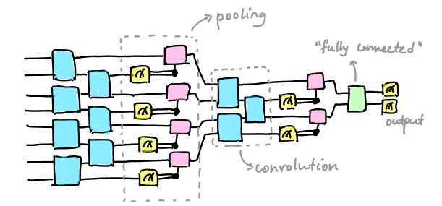
Parallel between QML and ML.

Slide 13
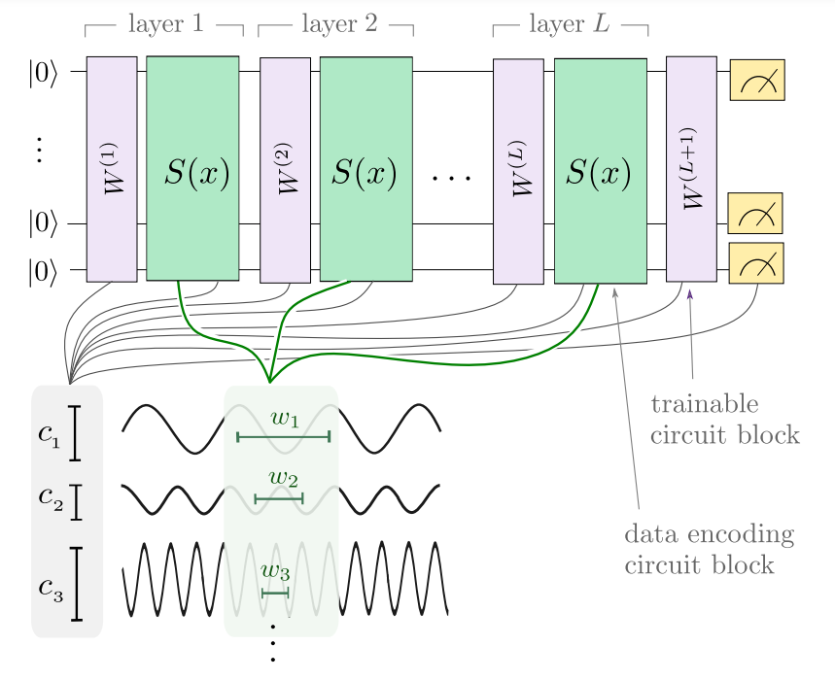
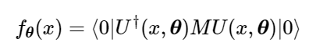
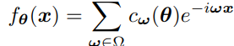
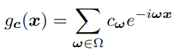
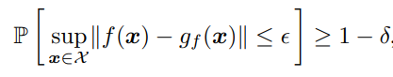
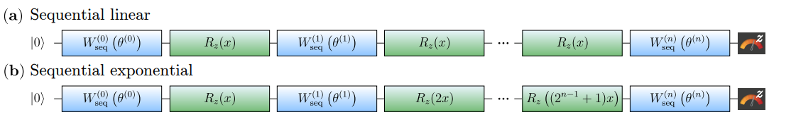
Fourier Model and Classical Surrogate Model for re-uploading QLM
Such that
Schreiber, F. J., Eisert, J., & Meyer, J. J. (Year). Classical surrogates for quantum learning models.
Schuld, M., Sweke, R., & Meyer, J. J. (Year). The effect of data encoding on the expressive power of variational quantum machine learning models.

Slide 14
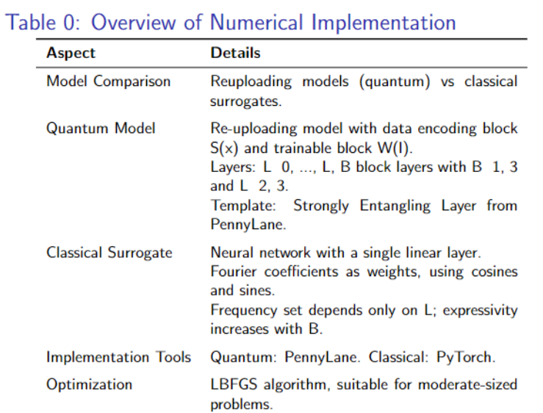
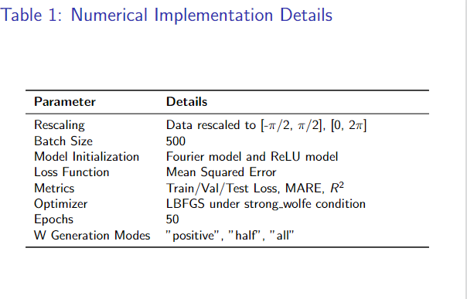
Implementations

Slide 15
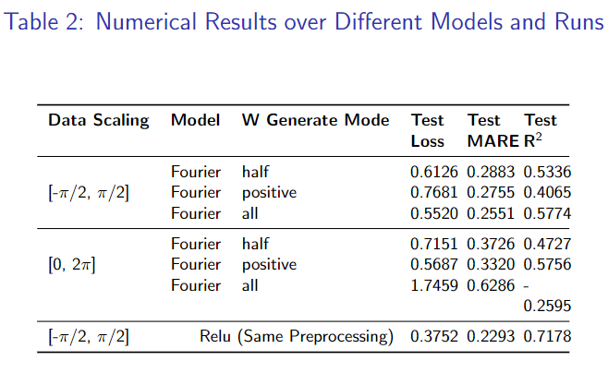
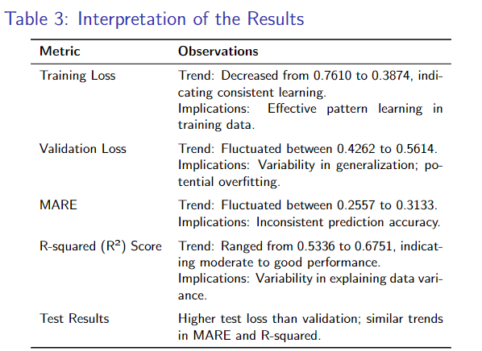
Results and Interpretations

Slide 16
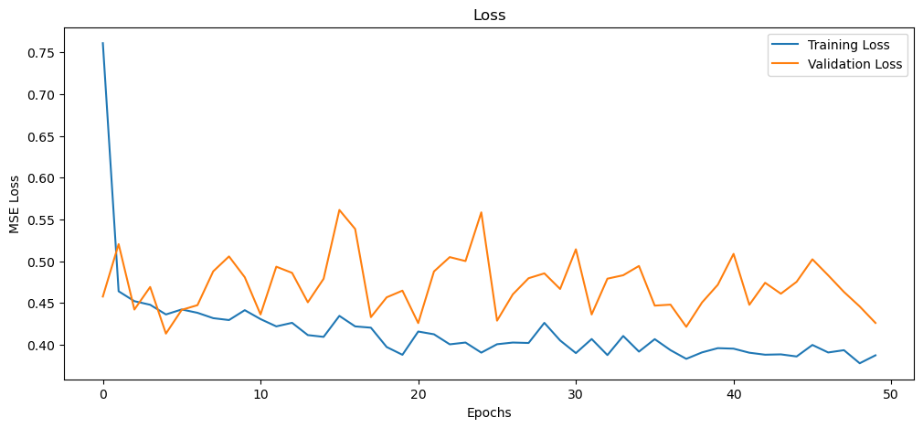
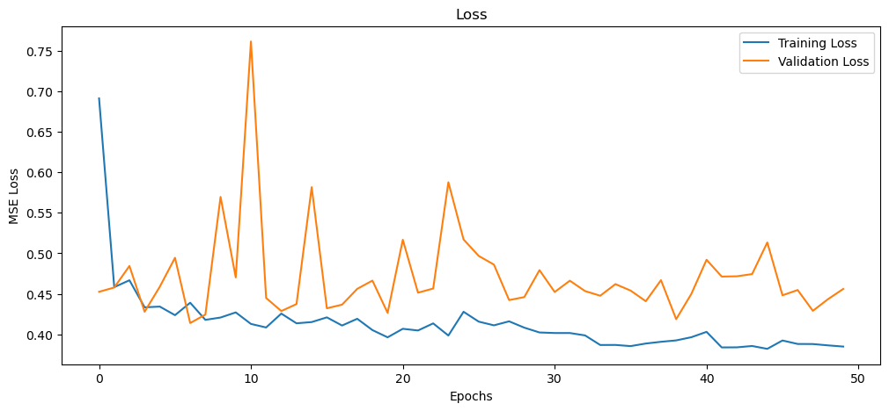
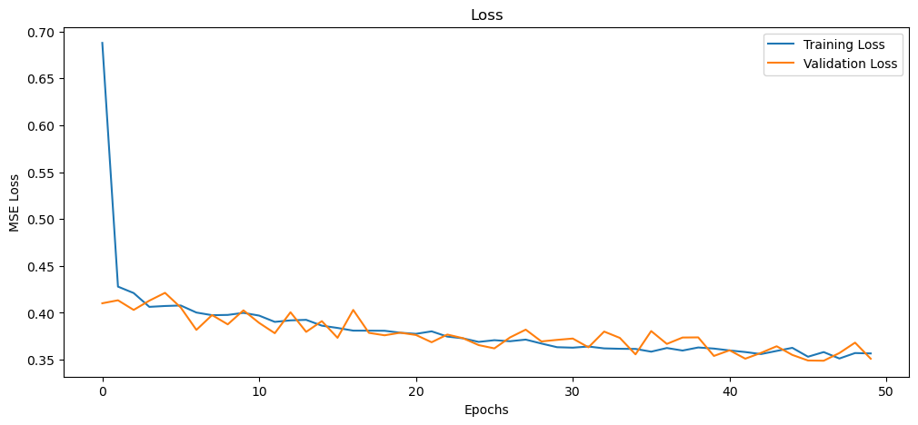
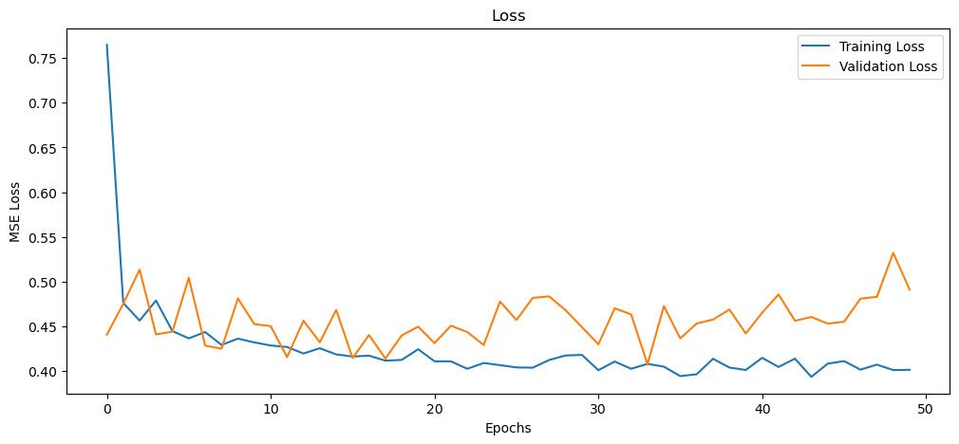
Results and Interpretations

Slide 17
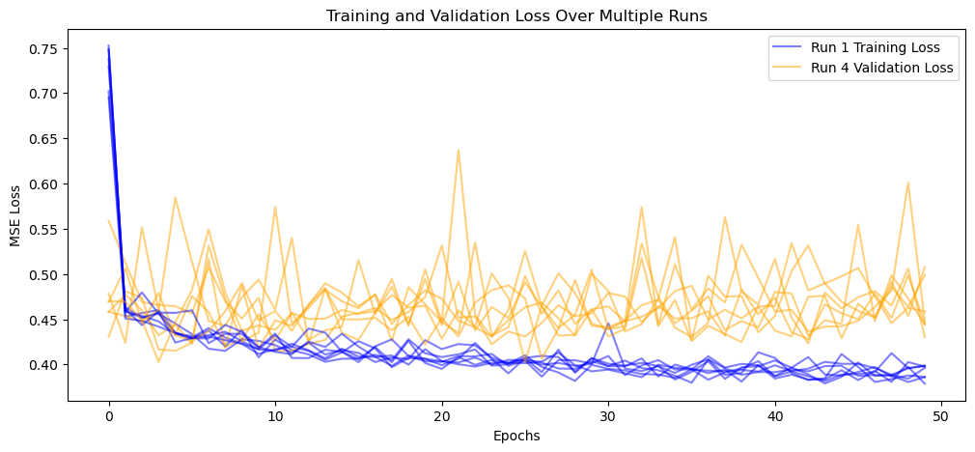
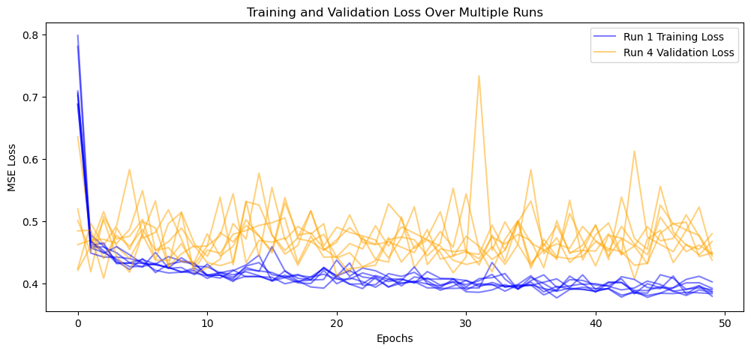
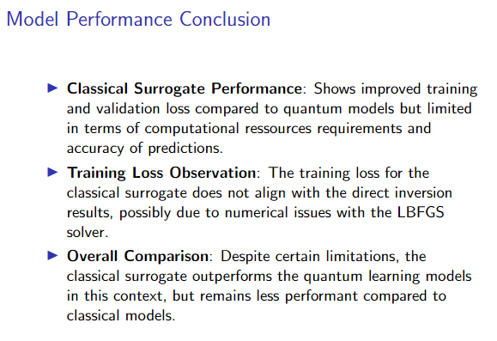
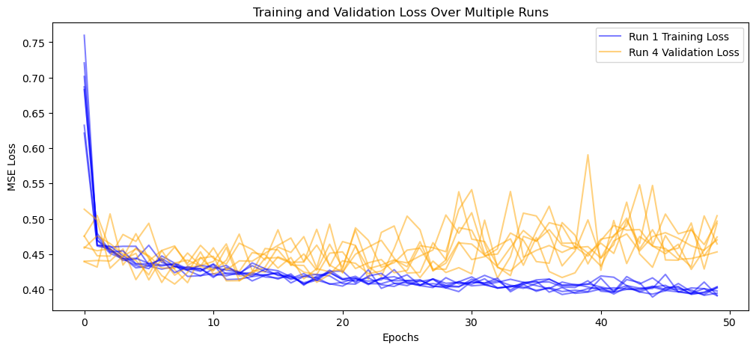
Results and interpretation

Slide 18
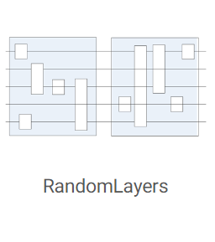
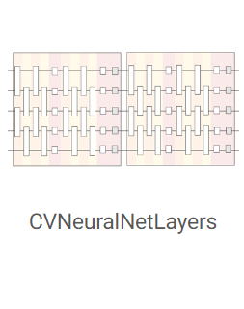
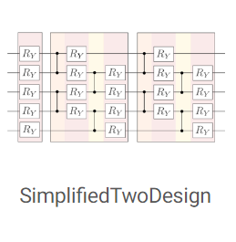
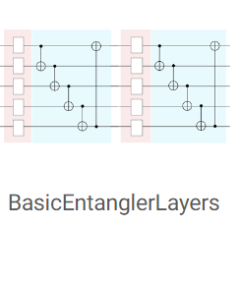
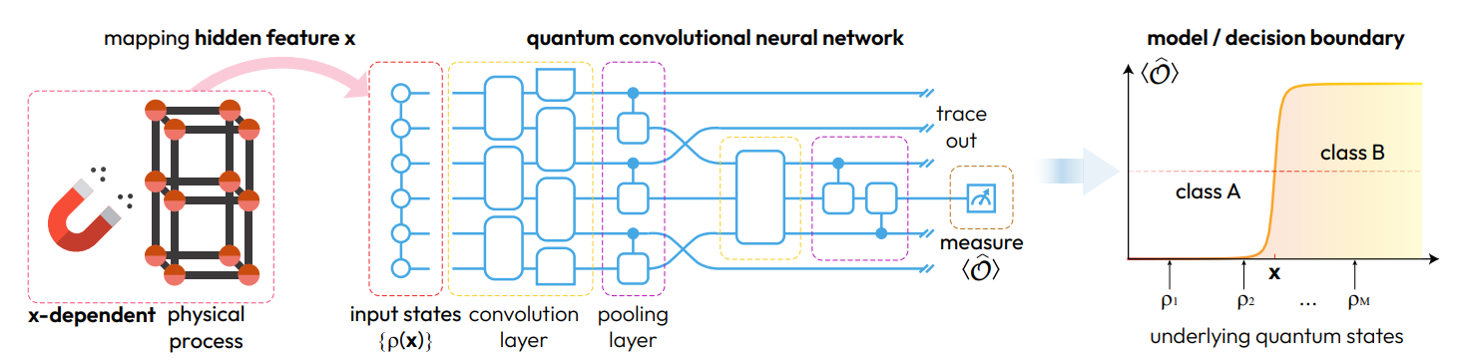
Future Work
Explore different QLM template & implement QCNN on high dimensional datasets.

Slide 19
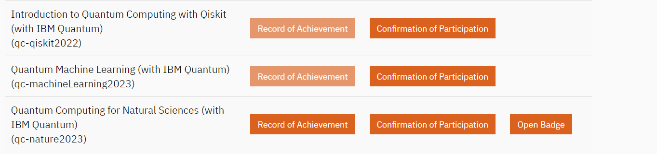
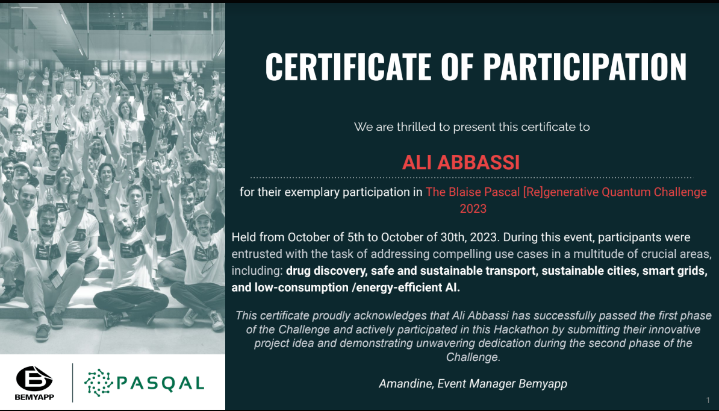
Reflections and insights
Acquired hands-on and theoretical insights in quantum computing and machine learning.
Developed soft skills pertinent to academic research and collaboration.
Learned version control systems for effective code management.
Operated virtual machines for computational tasks and simulations.(Not with ease)
Refined debugging skills for improved code efficiency and implementation.
Participated in a Qhackathon, fostering collaborative problem-solving.
Completed supplementary online courses to bolster theoretical knowledge.
Embraced continuous learning, integrating new quantum computing tools and methods.

Slide 20
—
Ali Abbassi
Ali.Sabir.Abbbassi@itwm.fraunhofer.de
Fraunhofer ITWM
Fraunhofer-Platz 1
67663 Kaiserslautern
www.itwm.fraunhofer.de

Slide 21
Vielen Dank für Ihre Gastfreundschaft und das Teilen Ihres Wissens.
—

Slide 22
Vielen Dank für Ihre Aufmerksamkeit
—

Slide 23
Bonus For Phd Students
—

Slide 24
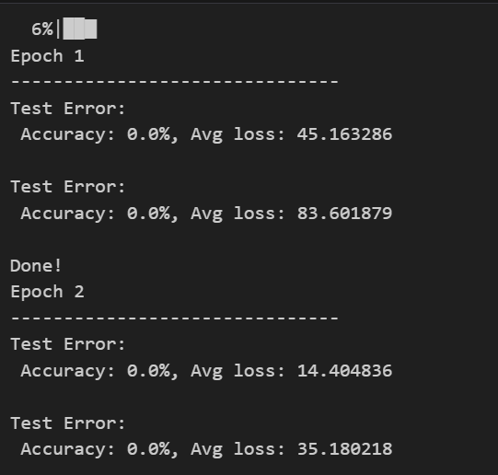

Substandard execution and methodology

Slide 25
Appendix
—

Slide 26
More details on Linear Vs Exponential re uploading
Reproduce the results and evaluate the relevancy of a quantum learning model
Key Task: Apply and extend concepts from [Paper Title] on quantum vs. classical models in regression + second paper
Approach: Results reproductibility and assessment
- Reproduce data re-uploading encoded quantum models with classical Fourier models.
- Experiment with exponential re-uploading in quantum models.
Analysis Goals:
- Benchmark performance up to 10-12 qubits.
- Assess quantum models for efficiency and potential advantages, including generalization.
Investigate potential quantum advantages.
Explore effects of different types of noise on model performance.

Slide 27



Neural Networks and Convolutional Neural Networks Workflow

Slide 28


Quantum Computing and re uploading models

Slide 29

Implementation and Results

Slide 30







Quizz Ressources
$$Data$$
$$x$$
$$Model$$
$$f(x,\hat{θ)}$$
$$Output$$
$$\hat{y}$$

